Slide 1

Public Finance Management
Why is it important?
March 20, 2014
Zagreb

Slide 2
Public Finance Management
The 2008 global financial crisis exposed many shortcomings in PFM systems throughout Europe and Central Asia
Many countries have taken drastic cuts to government services after a rapid decline in revenues—Croatia has mostly avoided those at the expense of the debt growth.
With population aging and increasing demands for government services to converge to the EU standards, PFM system will have to be strengthened to achieve fiscal sustainability, find efficiency savings, minimize fiscal risks, and improve competitiveness and service delivery.

Slide 3
PFM and Fiscal Performance
Many research papers have found a positive association between the quality of PFM systems and fiscal performance and the sovereign risk premium
Public Debt and Sovereign Ratings, 2013

Slide 4
Fiscal Performance and Growth
Public Debt and Economic Growth, 2008-12

Slide 5
PFM and EU
Large body of acquis – procurement, internal control, audit…
EU Governance Rules:
  Fiscal surveillance (medium-term budgetary objective introduced through the Stability and Growth Pact and to be embedded in the national law; adjustment path; and debt)
  Stronger institutions at national level (independent fiscal authorities and independent forecasts, fiscal rule, minimum standards on accounting, statistics, transparency)
  Croatia under the Excessive Deficit Procedure

Slide 6
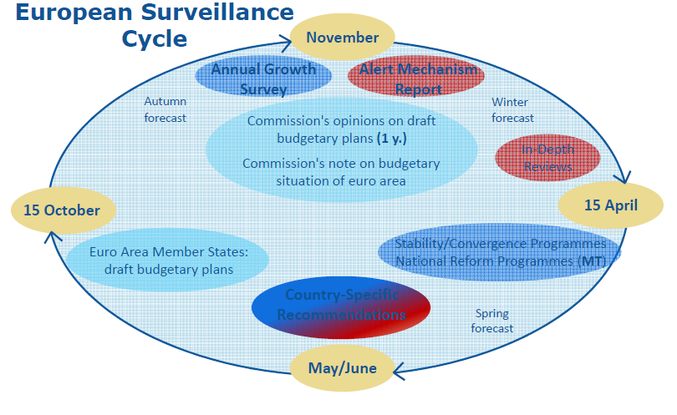

Slide 7
What PEFA Might Find at Local Levels?
Likely weaknesses:
  policy-based budgeting and decision-making;
  management of contingent liabilities and arrears;
  tax collections;
  governance and accountability;
  FM information systems,
  forecasting;
  transparency and budget comprehensiveness.

Slide 8
What PEFA Might Find at Local Levels?
Some improvements:
  internal audit;
  predictability and control of budget execution;
  credibility and medium-term budget planning;
  procurement.
However, the modern internal audit concept, as a risk management tool to enhance the effectiveness and efficiency in operations, has not yet gained roots. Likewise, the PIFC concept that emphasizes managerial accountability, has not yet taken hold.
Public Investment Management. Despite greater use of cost-benefit analysis, non-objective project selection remains a dominant mode of capital budgeting.

Slide 9
Thank you for your attention
www.worldbank.org
https://facebook.com/worldbank
https://twitter.com/WorldBank

