Slide 1
Local and Regional Self-government Committee Thematic Session “What sort of Mountain Area Law Croatia needs” Croatian Parliament, Ivan Mažuranić Hall, 26 April 2018 ___________________________________________________________________
The Swiss Experience
with Development of the
Mountain Areas

Slide 2
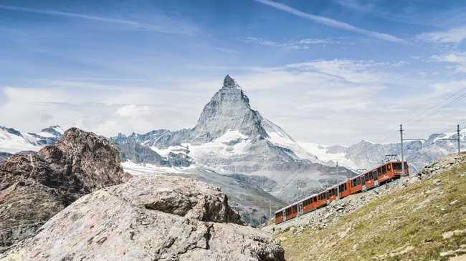
The Mountains: Our Identity Switzerland: 48 Mountain Peaks higher than 4000m (Matterhorn: 4478m)

Slide 3
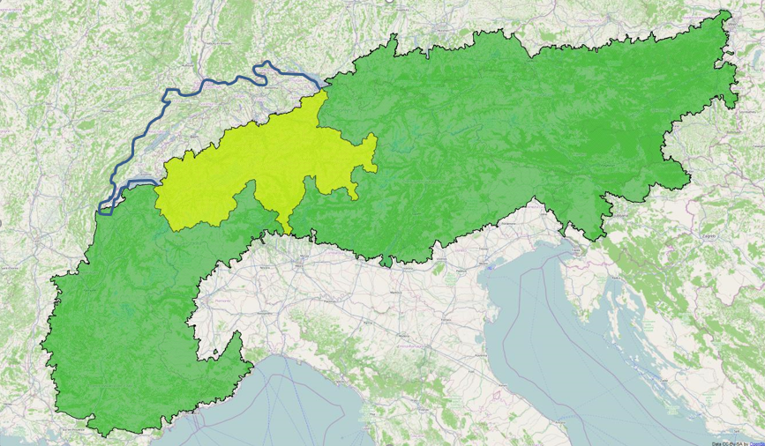
The Alps: Shared by 8 Countries Members of the Alpine Convention (www.alpconv.org)

Slide 4
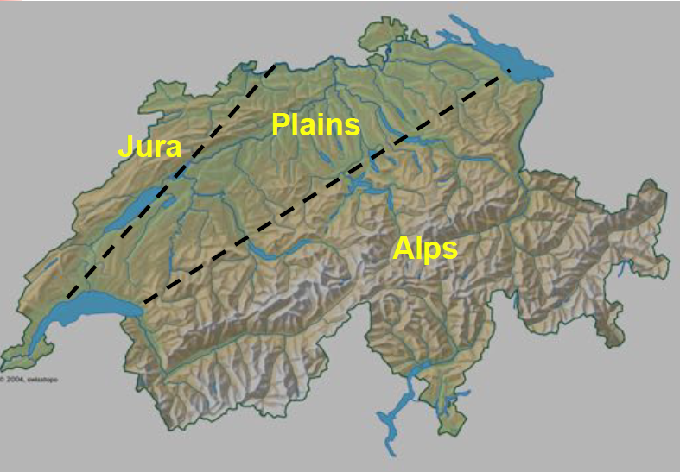
Mountain Areas in Switzerland Mountain Area: 2/3 of Surface, 1/4 of Population

Slide 5
Urban Centers 6 Major Cities with > 100’000 Inhabitants
Zürich
Winterthur
Basel
Bern
Lausanne
Geneva

Slide 6
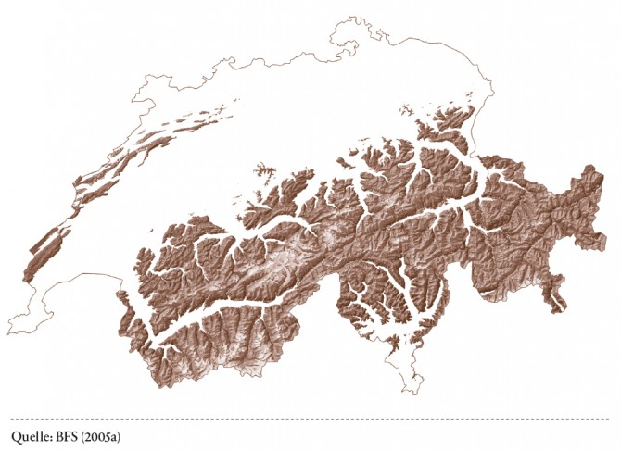
The «Upper Half» of Switzerland If you draw the line at 1080m, half of the surface of Switzerland is below and halve above that level.

Slide 7
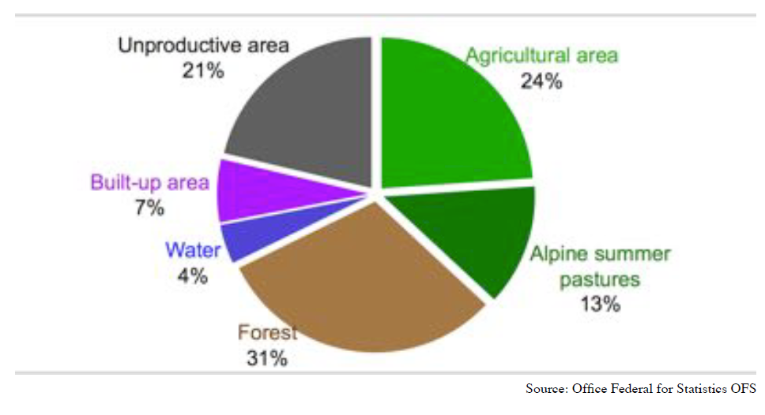
Switzerland: A Country Shaped by Agriculture Total Surface 41’000 Km2 (Croatia: 57’000 Km2)

Slide 8
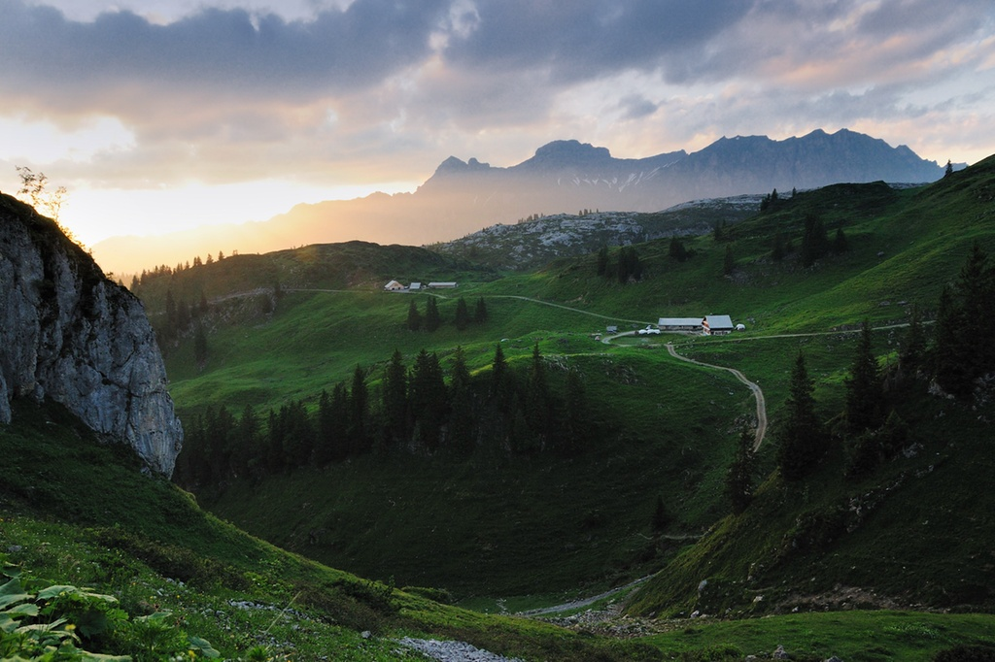
Alpine Pastures

Slide 9
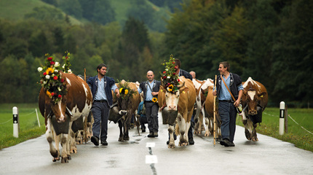

Slide 10
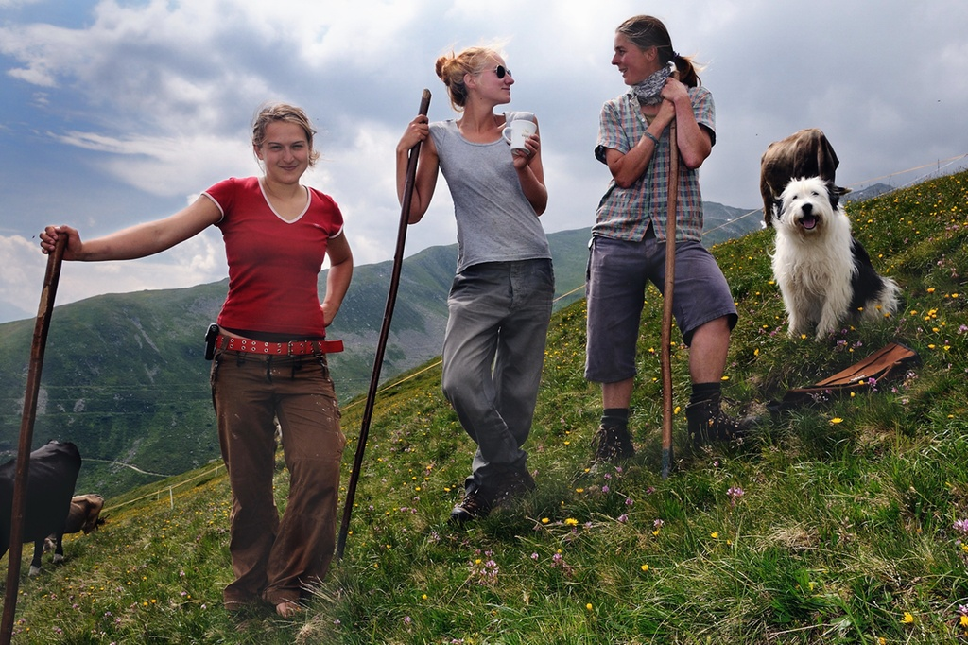

Slide 11
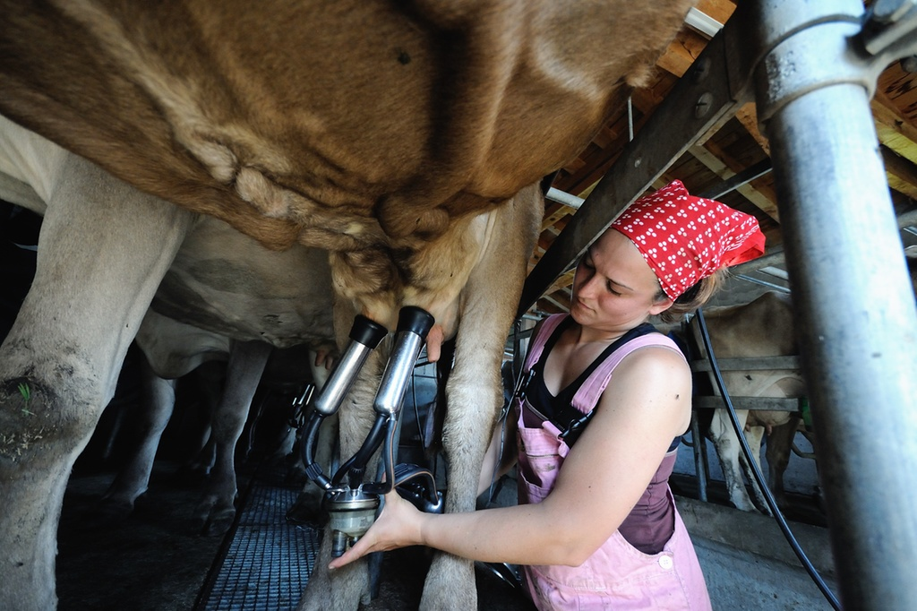

Slide 12
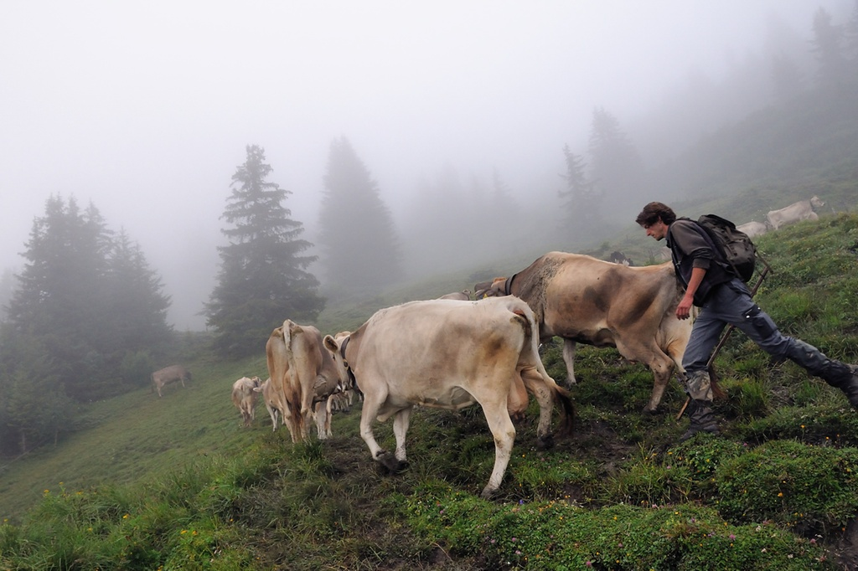

Slide 13
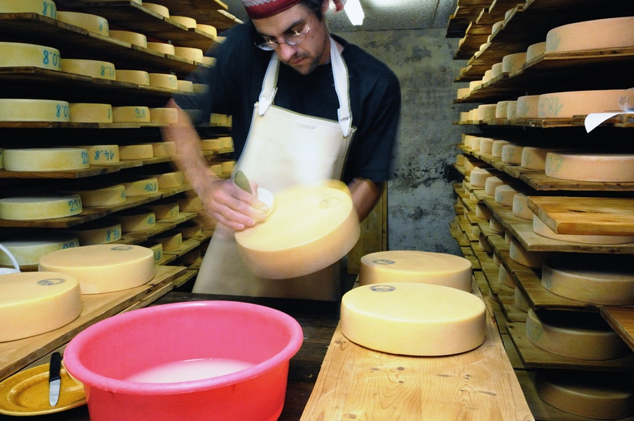

Slide 14
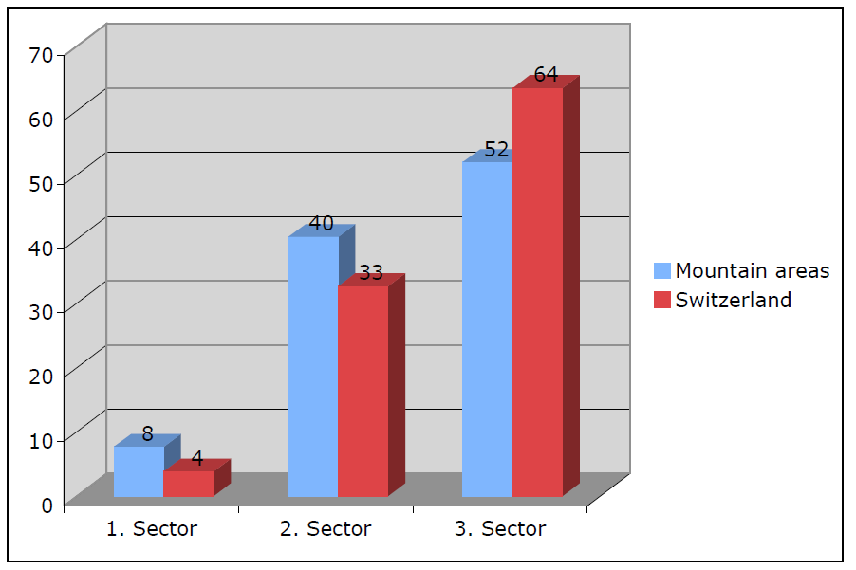
Economic Structure in Switzerland

Slide 15
The New Financial Equalization (NFE) of 2004
26 Cantons, currently 9 contributing and 17 receiving
A common project between Confederation and Cantons
System was reformed in 2004: Create a more dynamic system, taking into account development and potential of Cantons
Parliament can steer the process and correct it every 4 years
Equal compensation for mountain and urban areas

Slide 16

The New Regional Policy (NRP) of 2008
The New Regional Policy (NRP) of the Federal Government to support mountain and other rural areas and border regions
Three Objectives:
Promotion of Innovation (main pillar) Encouraging Competitiveness, system of subsidies and loans
Creation of Synergies (accompanying objective) Coordination of Sectoral Policies
Sharing of Knowledge (support network, knowledge platform) www.regiosuisse.ch

Slide 17
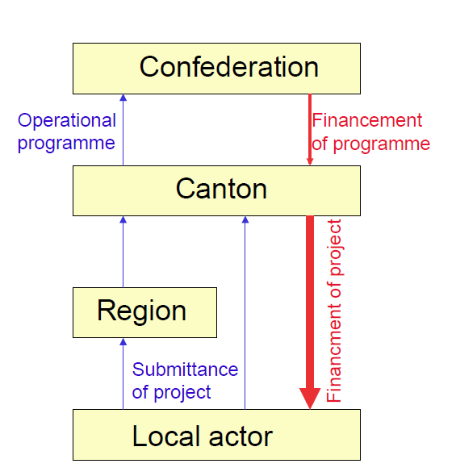
Institutional Setup of the Regional Policy in Switzerland
Federal Law on Regional Policy
(Multiannual Programme)
Cantonal Laws
(Operational Programmes)

Slide 18
Agriculture and Direct Payments
Art. 104 of the federal constitution:
Ensured supplies, environmental stewardship,
Conservation of the natural heritage, decentralised settlement,
Promotion of particularly natural production methods that are
Environmentally friendly and meet animal welfare criteria
Types of subsidies:
Farmland payments
Payments for ensuring supplies
Biodiversity payments
Payments for landscape quality
Payments for production systems

Slide 19
Development of Mountain Areas: A Cross-Sectoral Task
Spatial Development and Planning (Linking urban and rural/mountain areas, defining functional spaces)
Roads, Public Transportation, Infrastructure and Telecommunications (100 years ago: Road connections; today: fast internet)
Agricultural Policy (System of subsidies, recognition of functions other than production – cultivated landscape, nature conservation, security of supply –, improving value chains)
Tourism Policy (Supporting structural change in tourism)
Environmental Policy (Protection of landscapes, national parks, coping with the effects of global warming, maintaining biodiversity)
Energy Policy (Exploiting hydropower, water fees, wind and solar energy)

Slide 20

Policy for Rural and Mountain Areas

